Slide 1


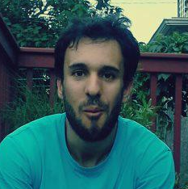






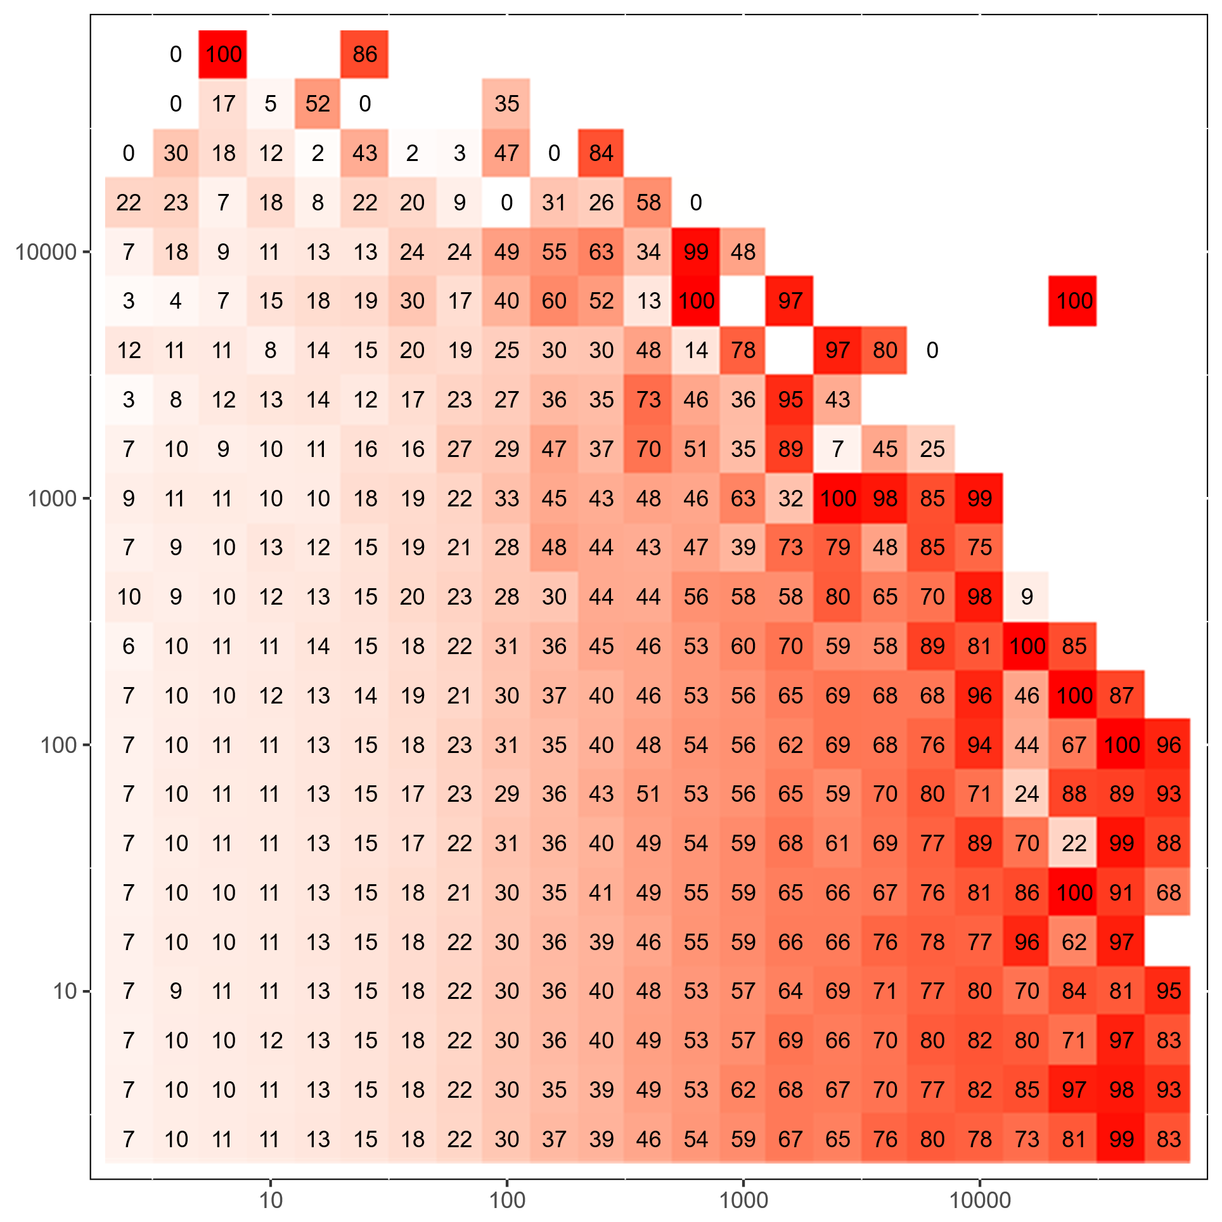

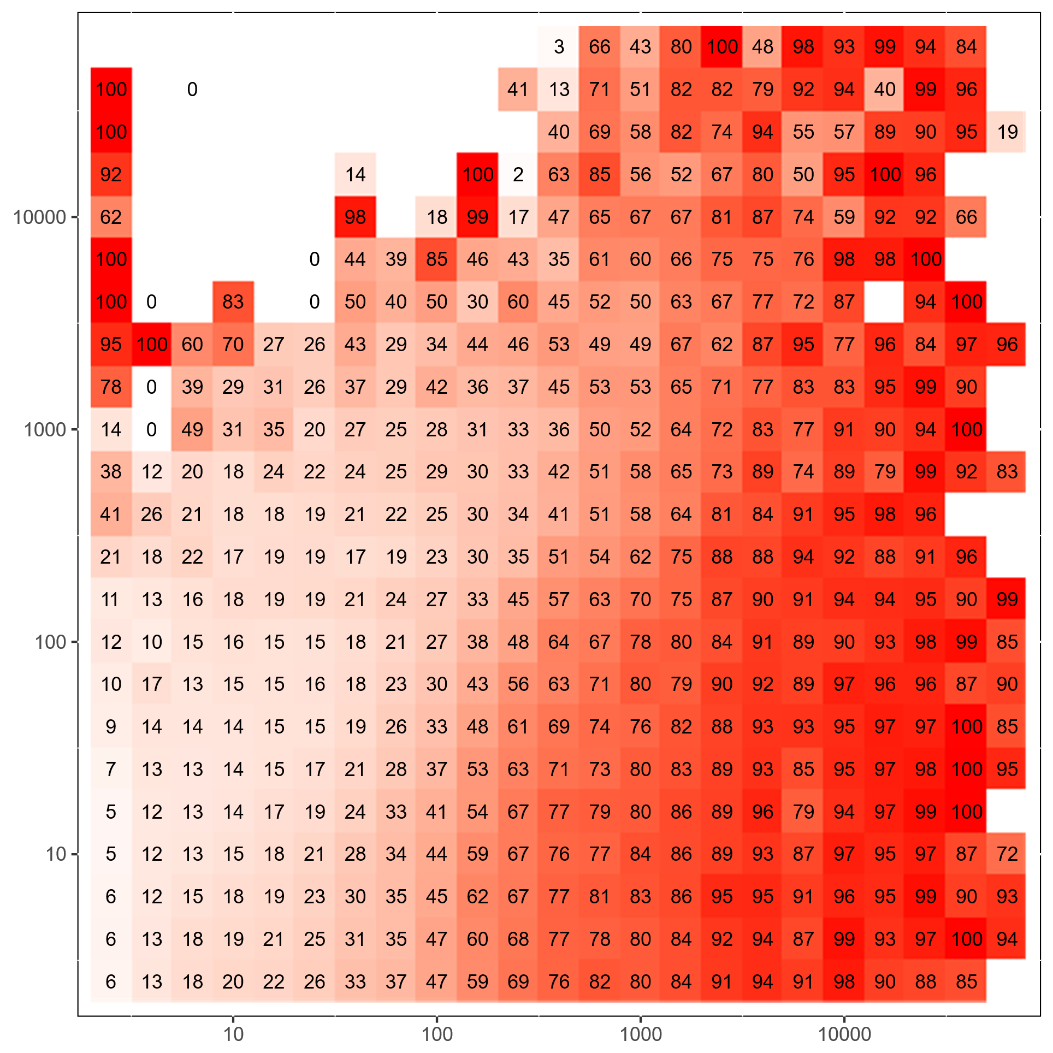
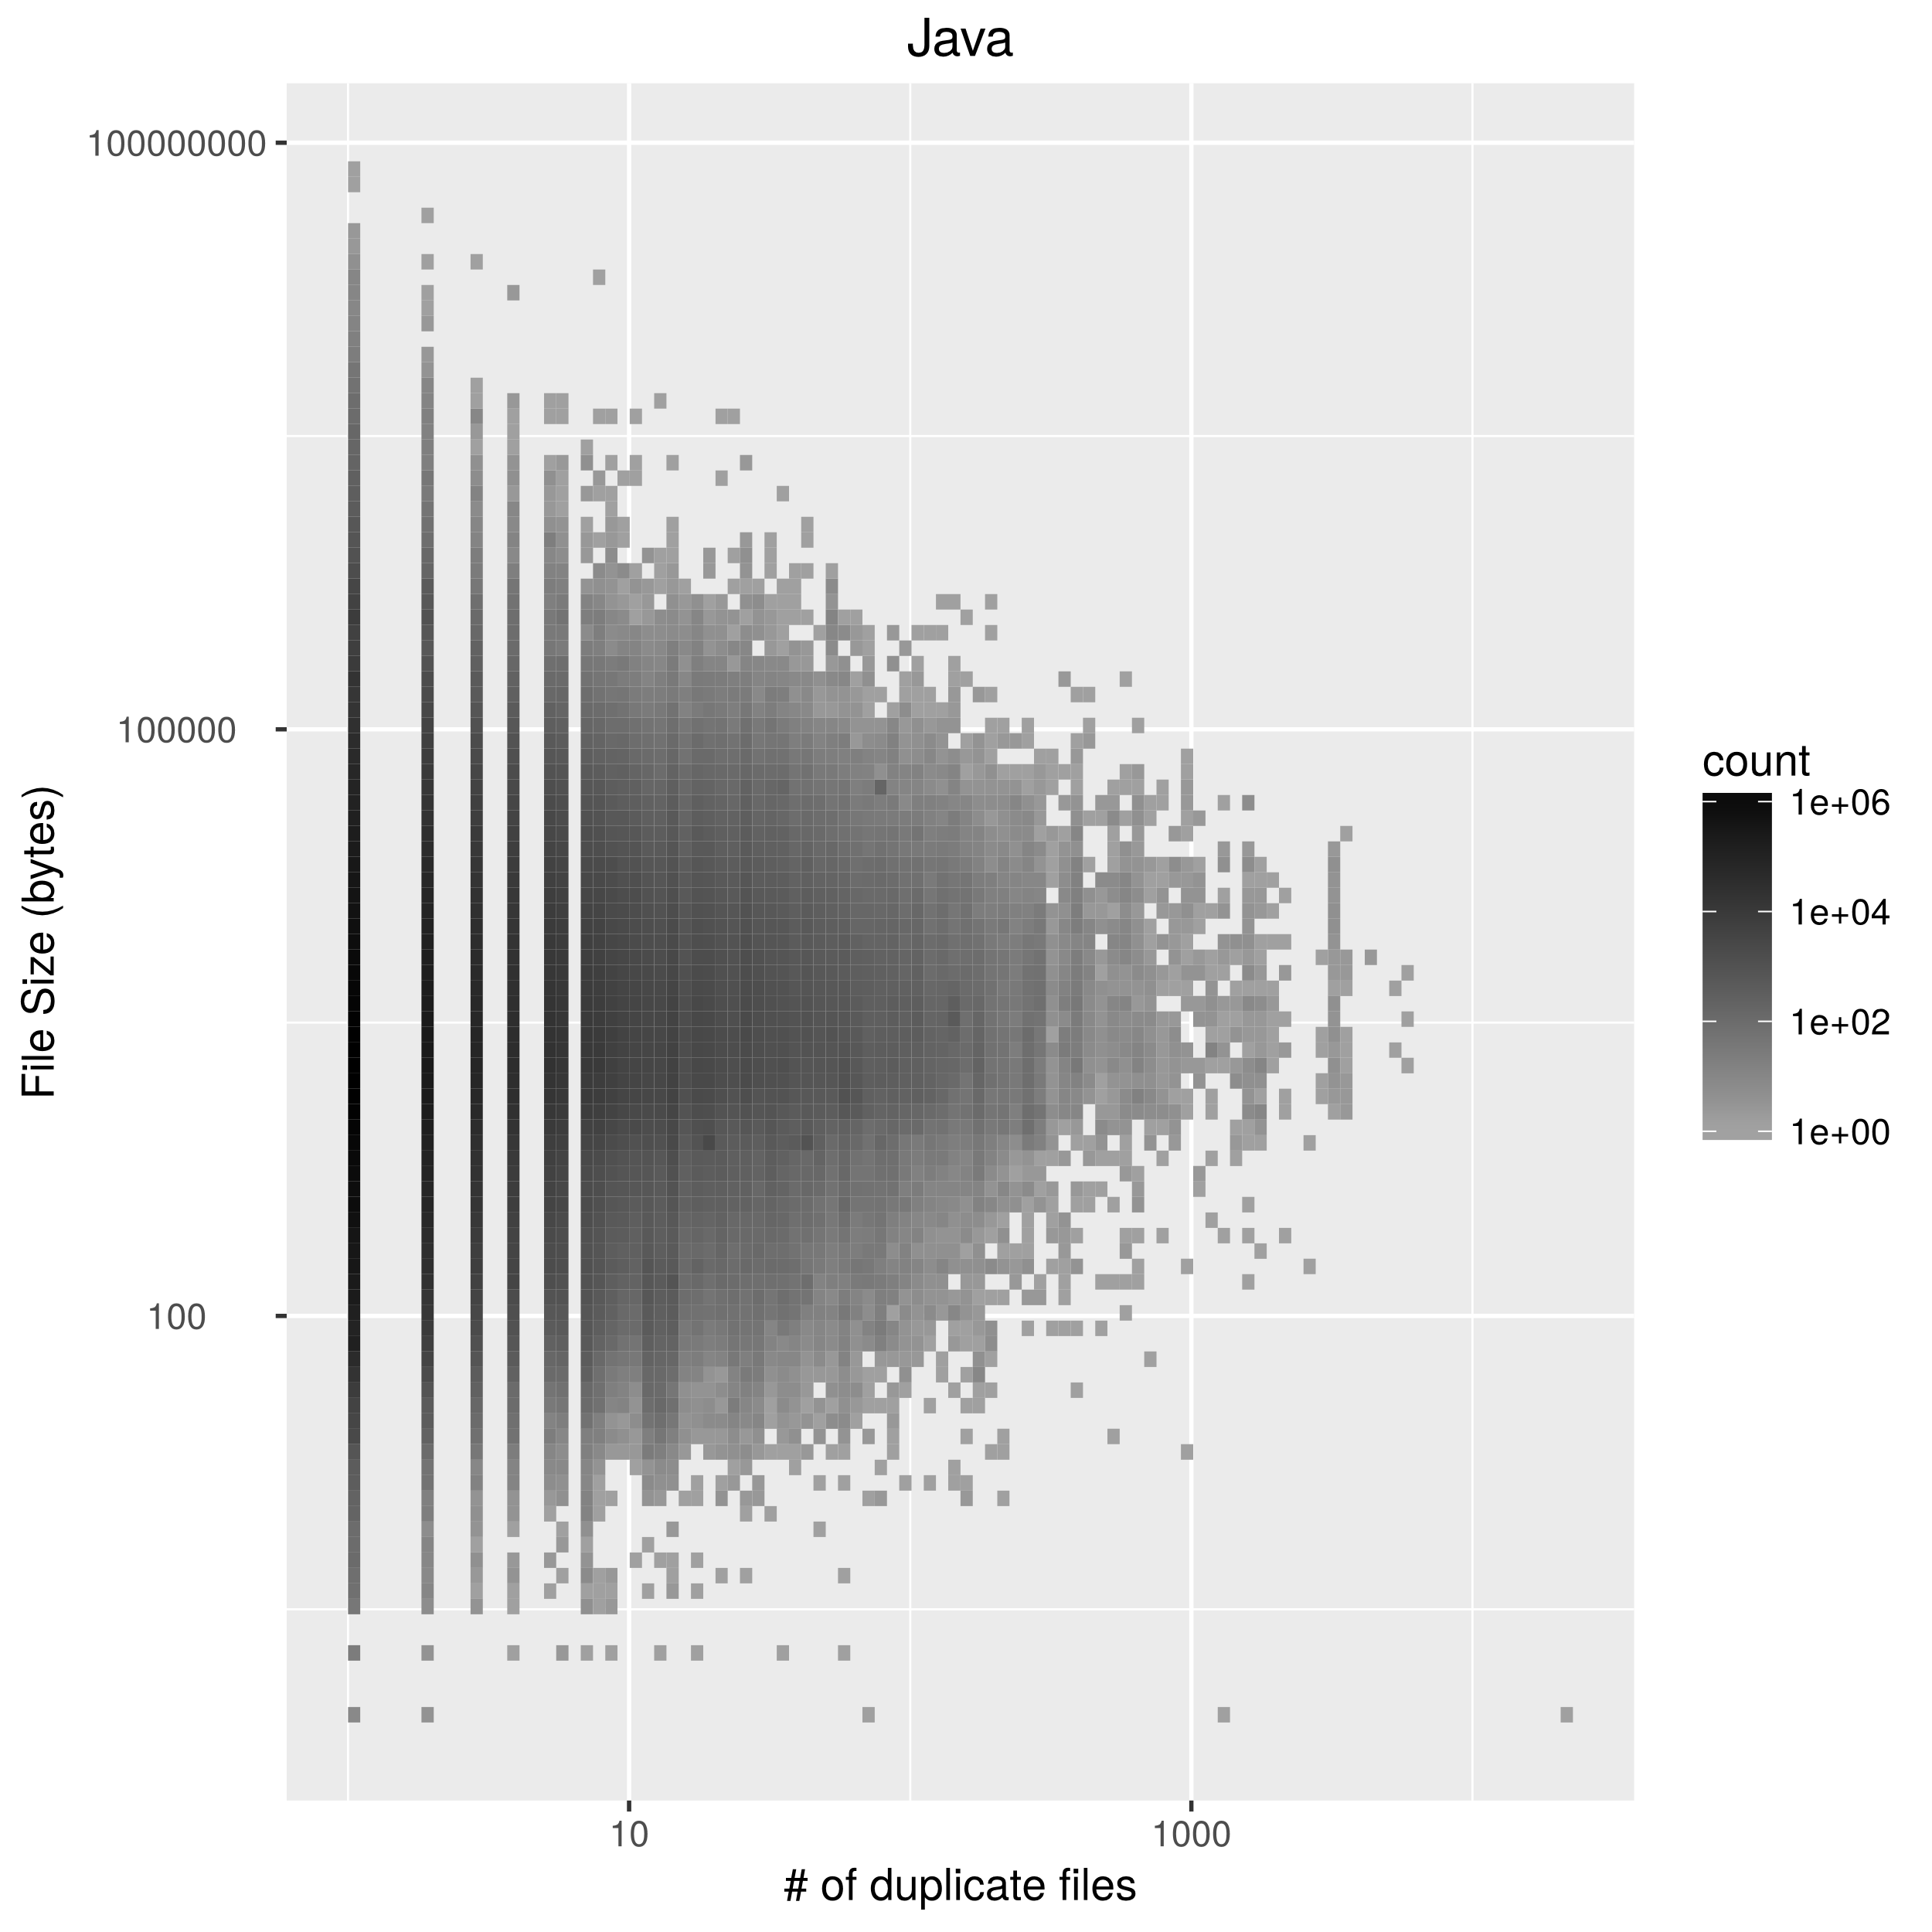
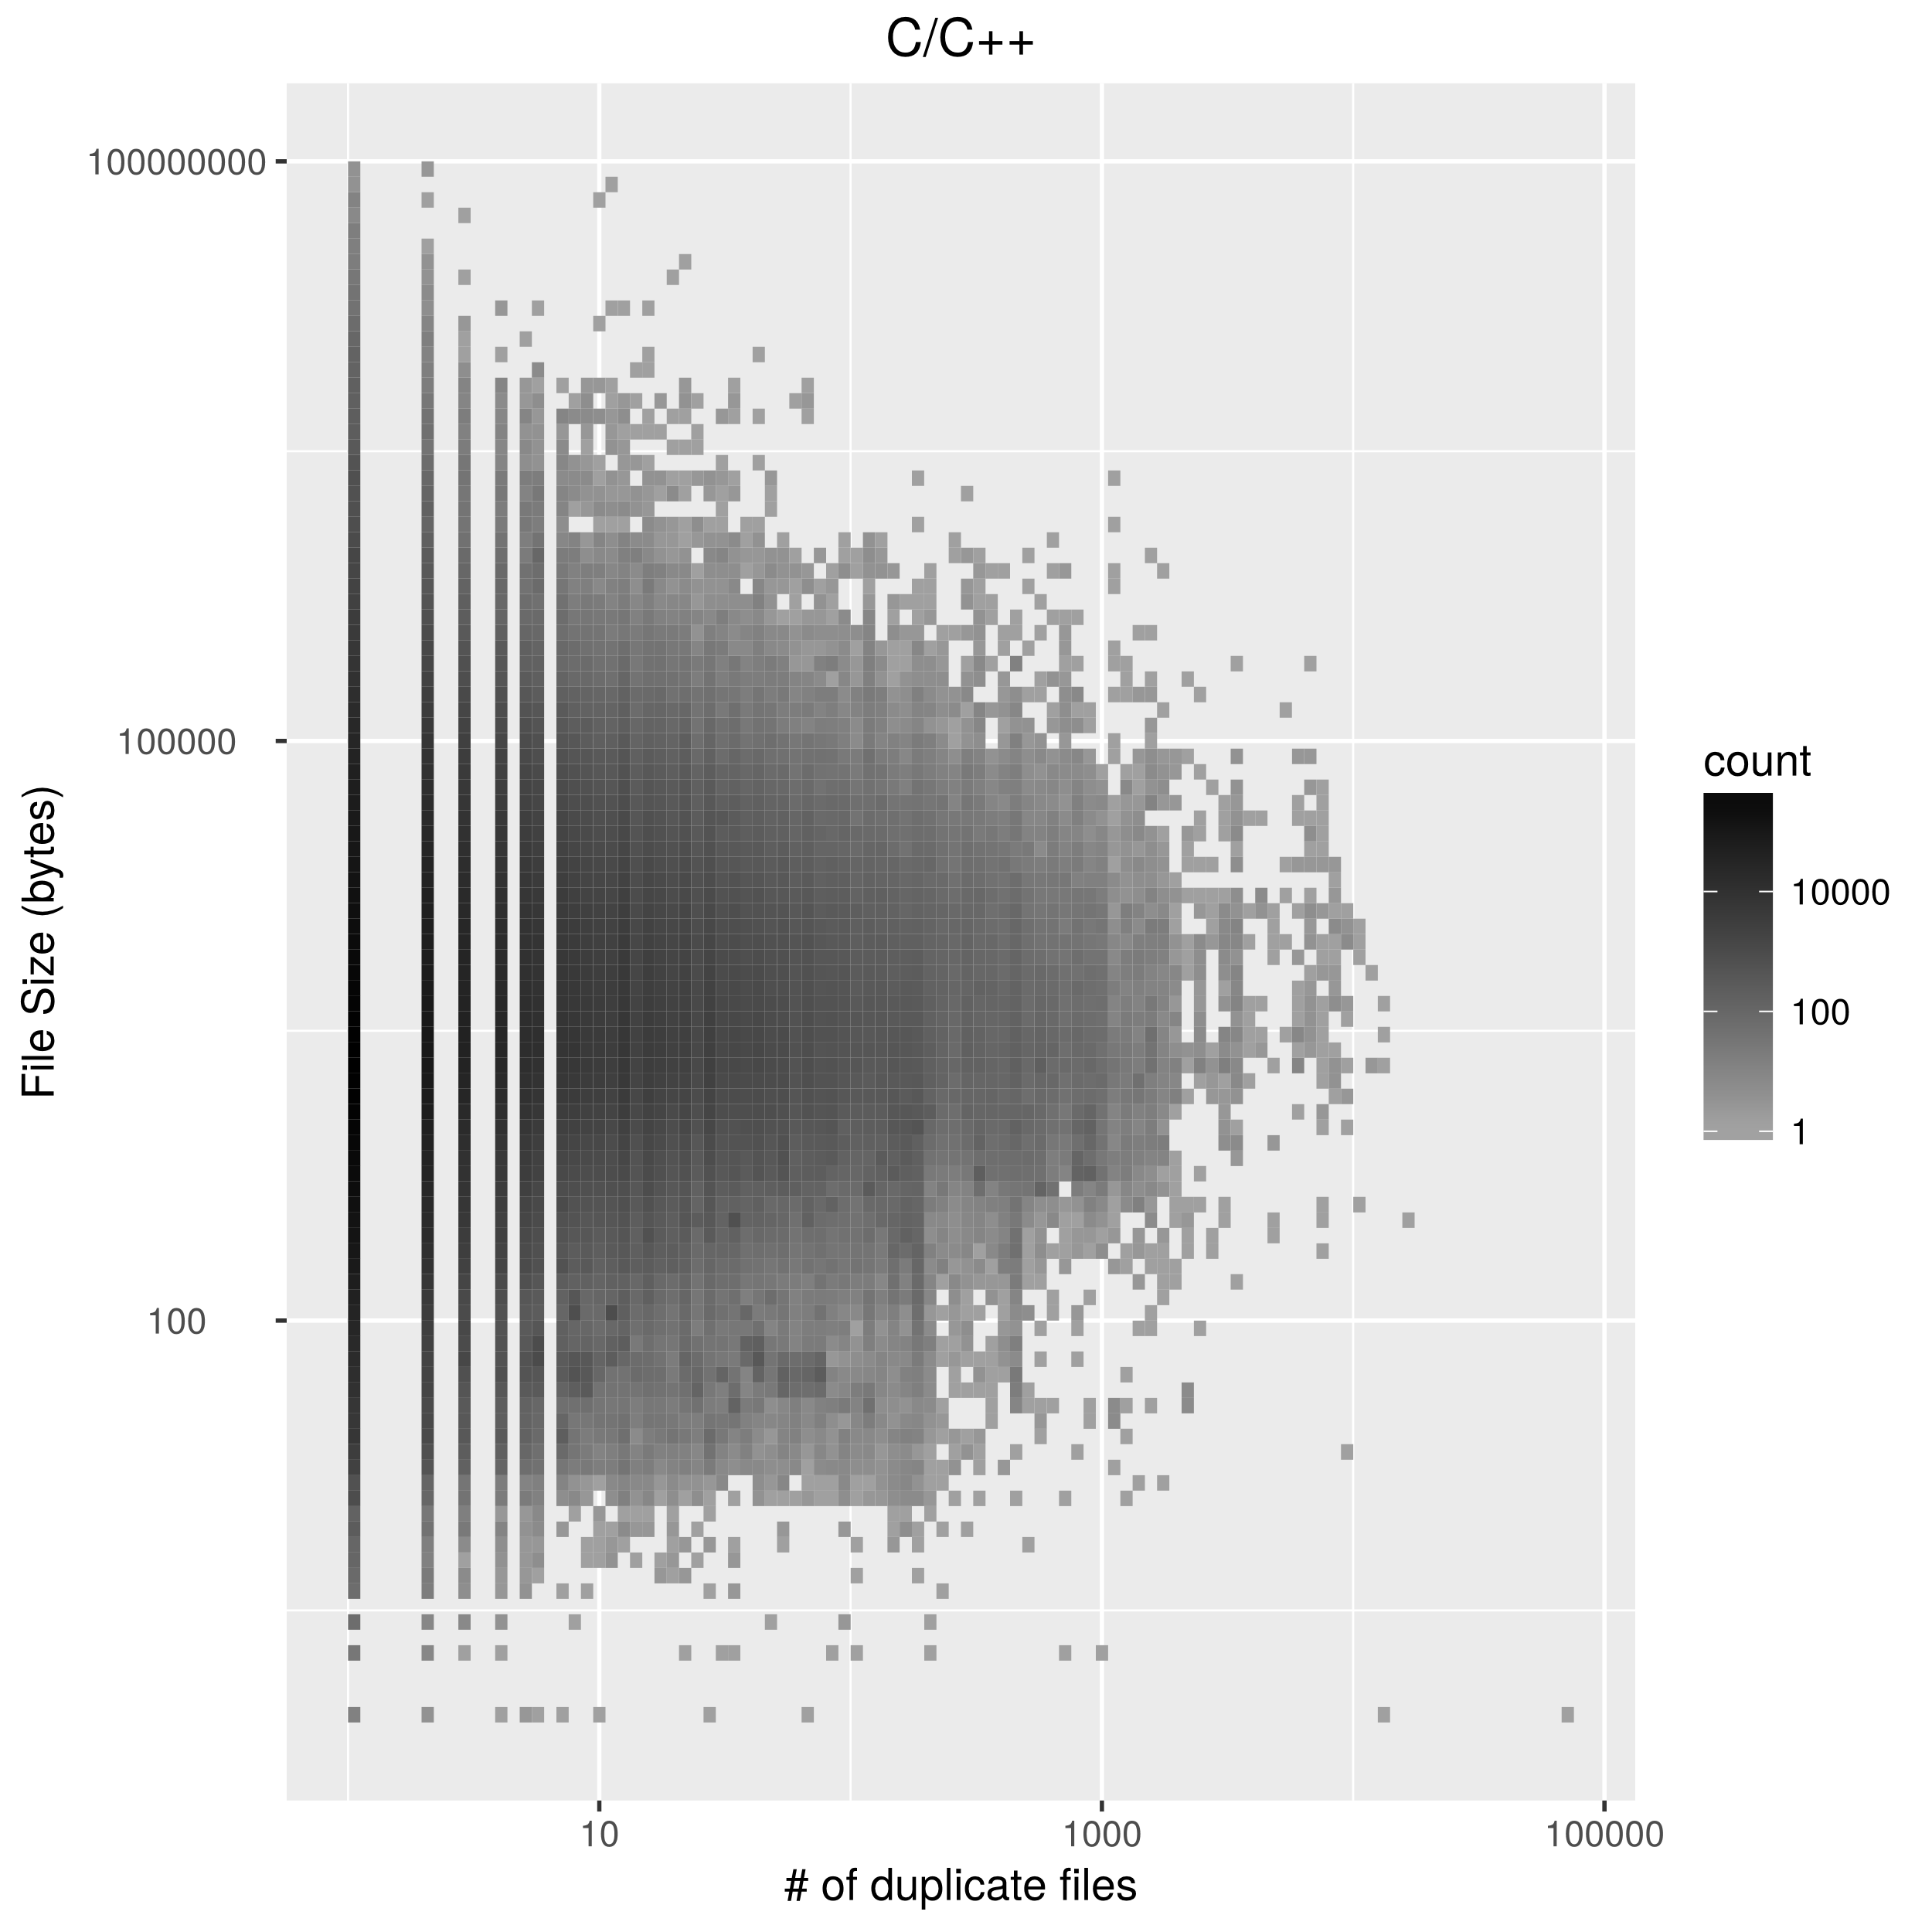
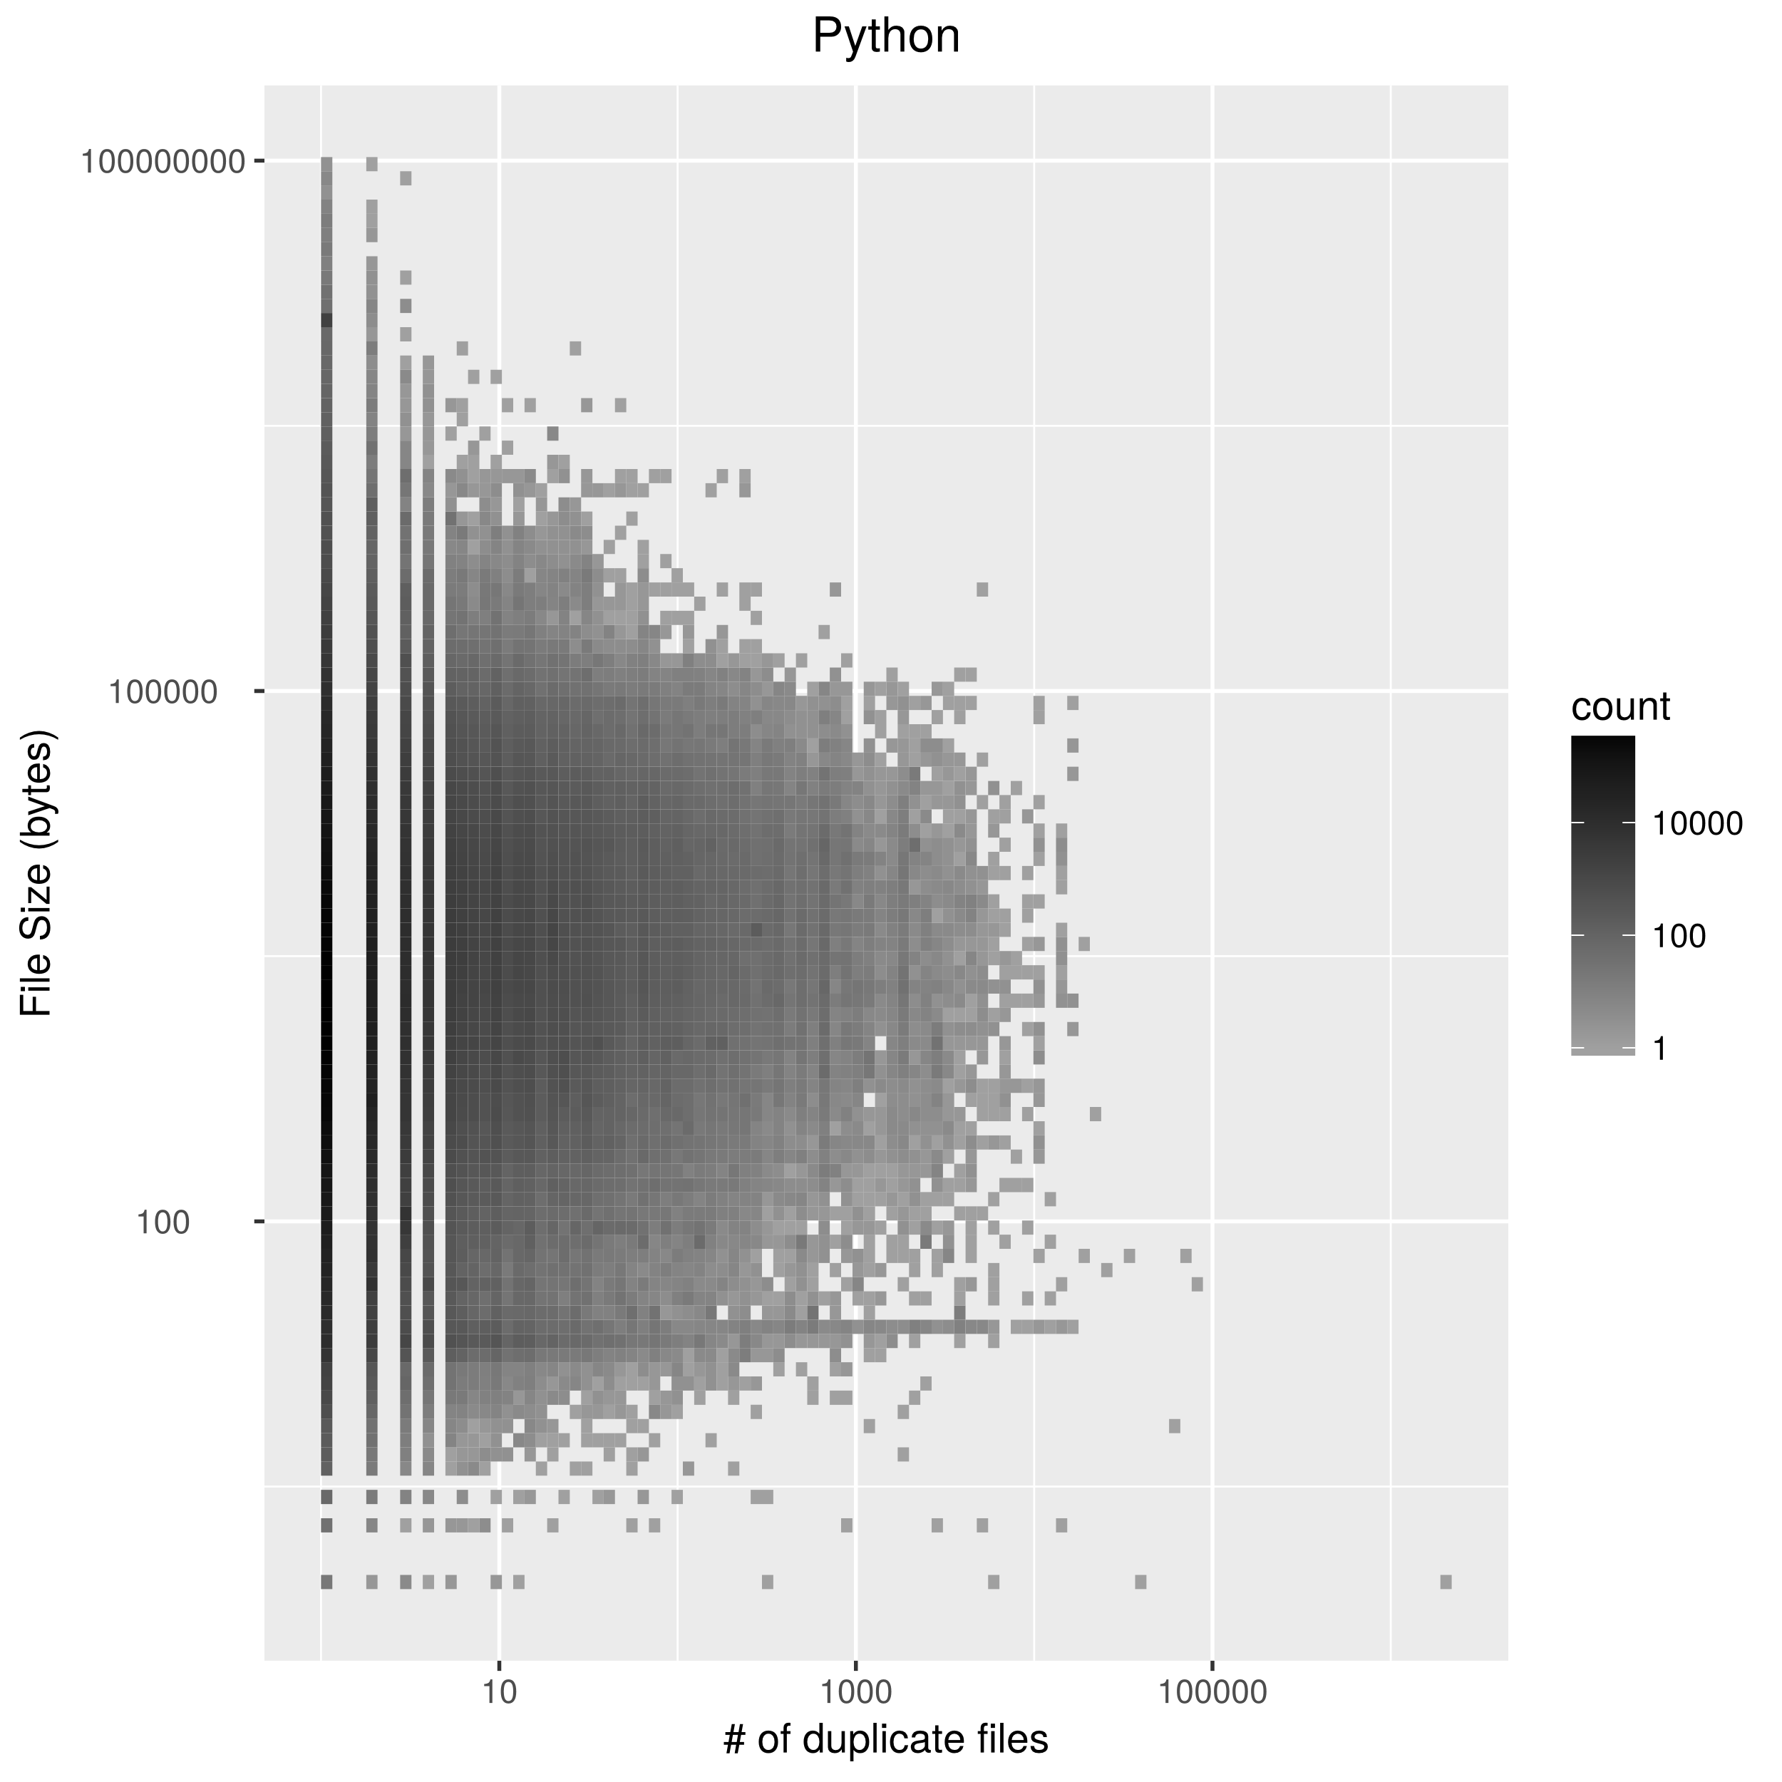
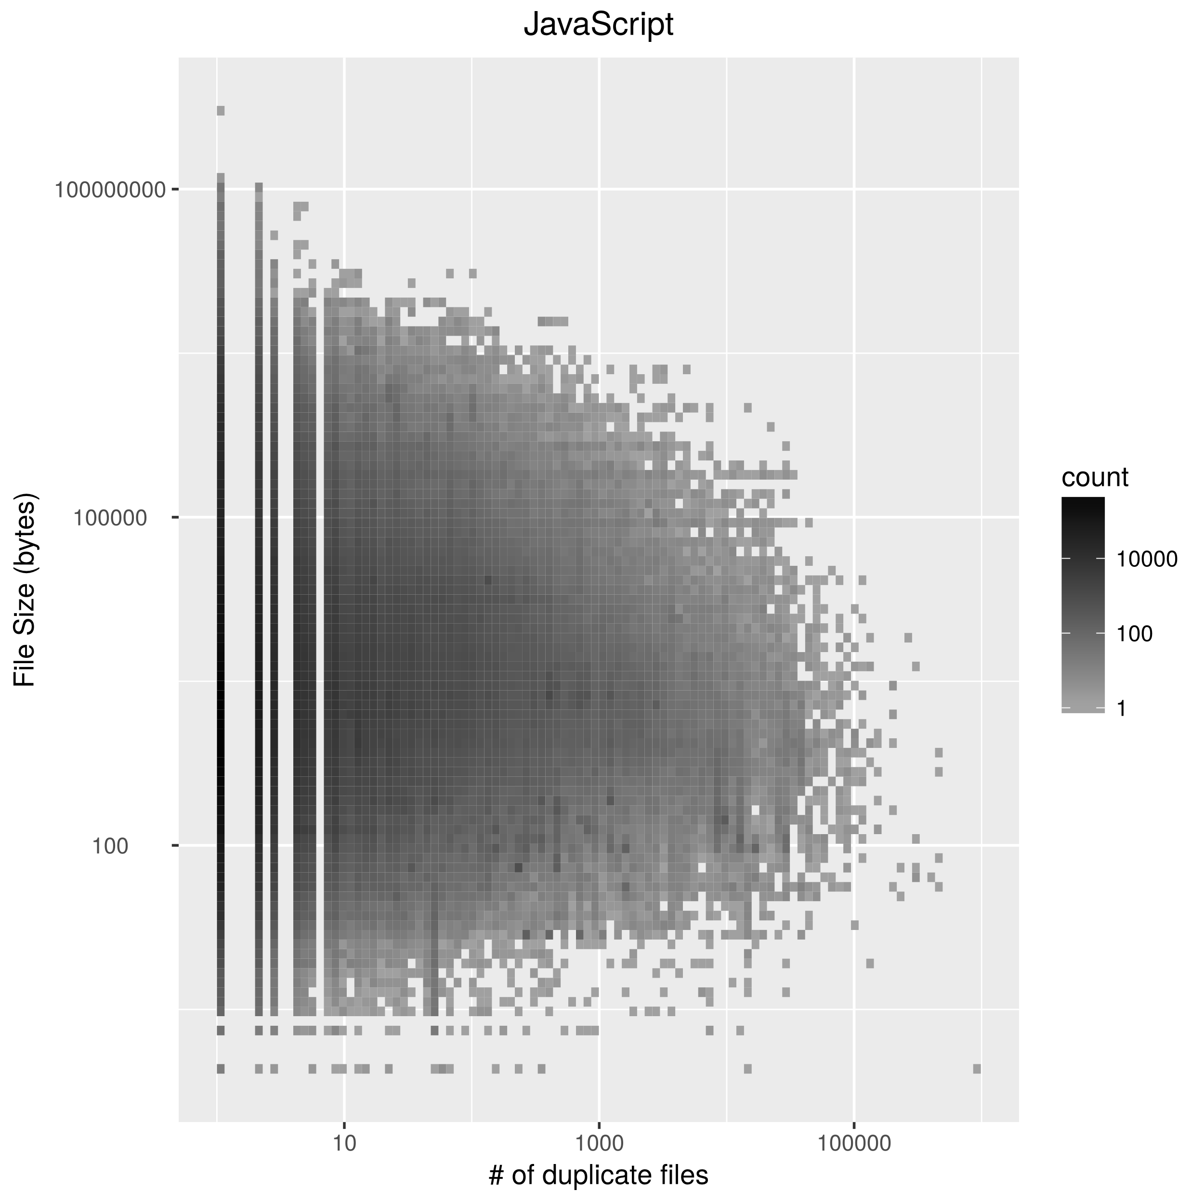
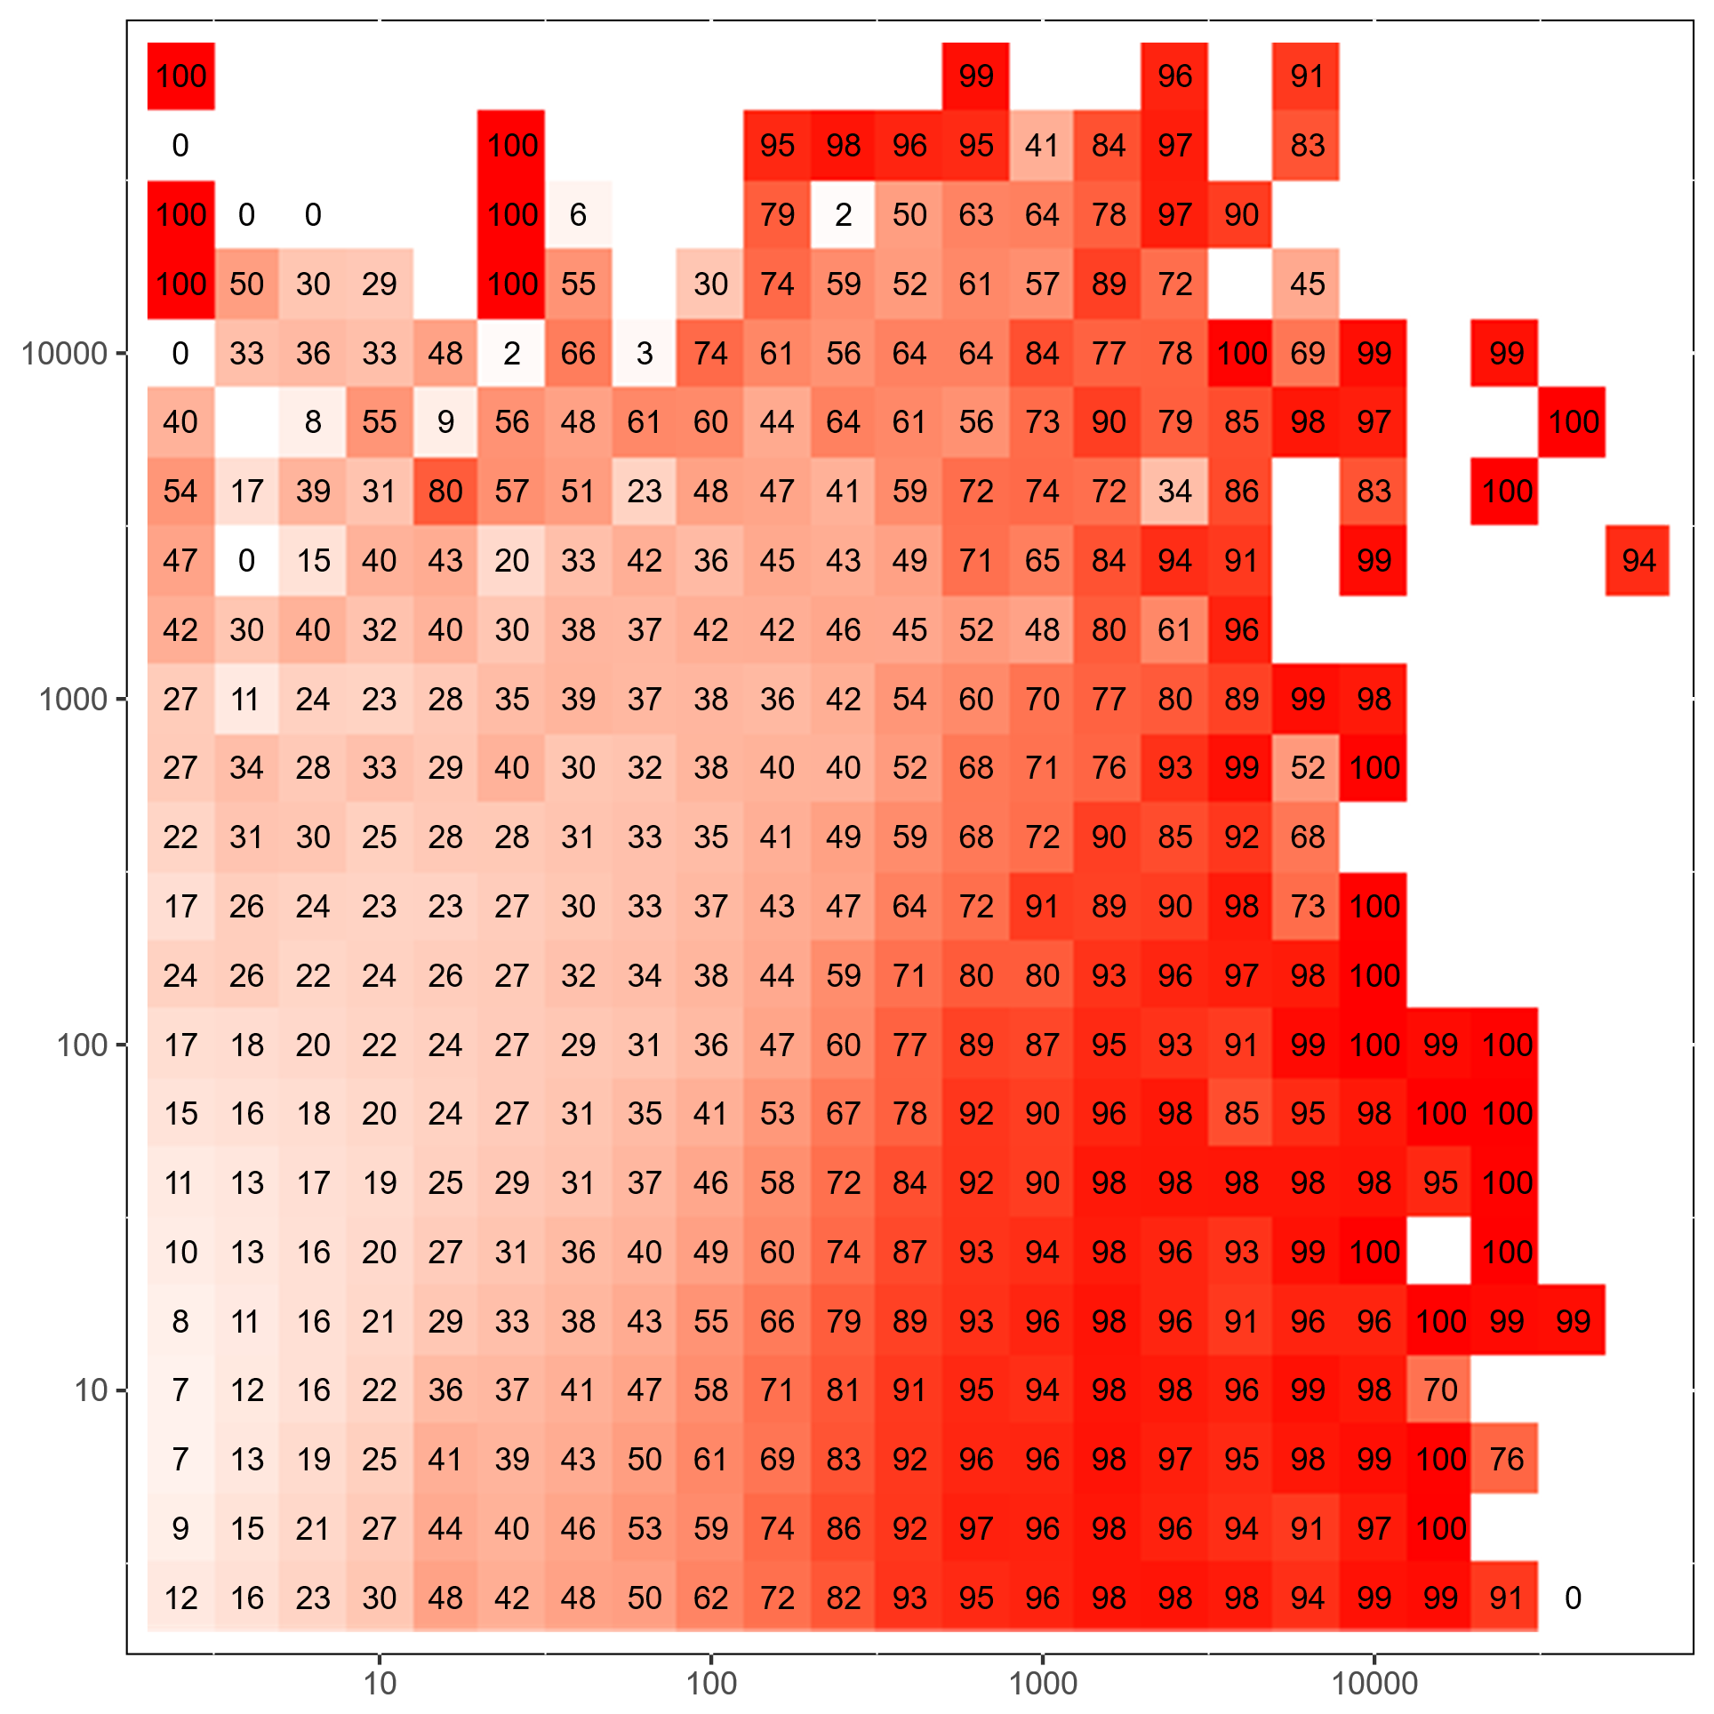
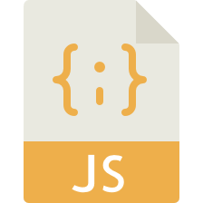
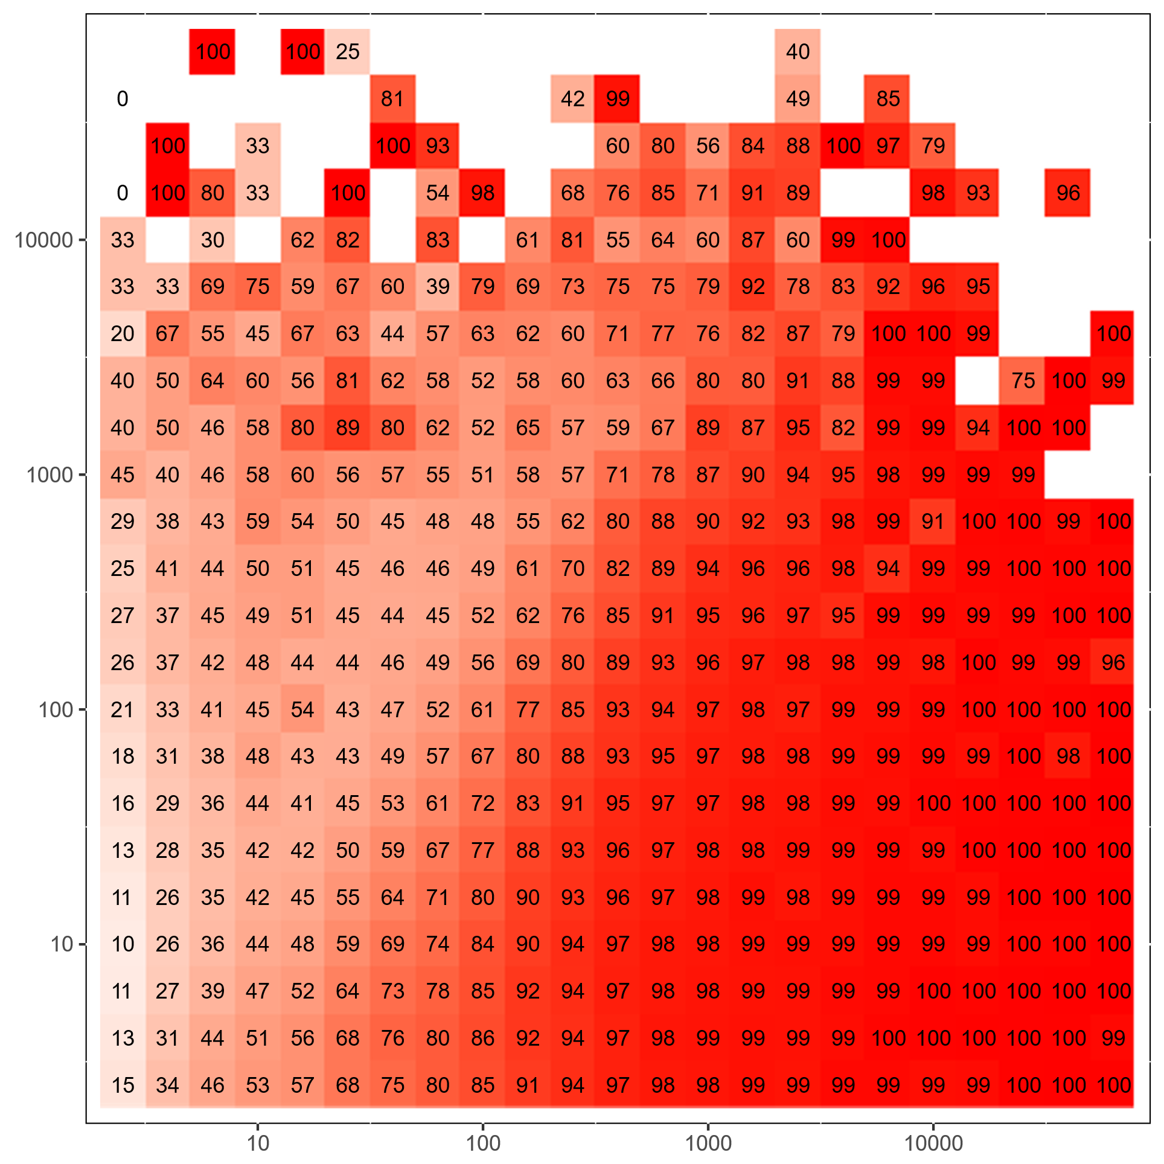

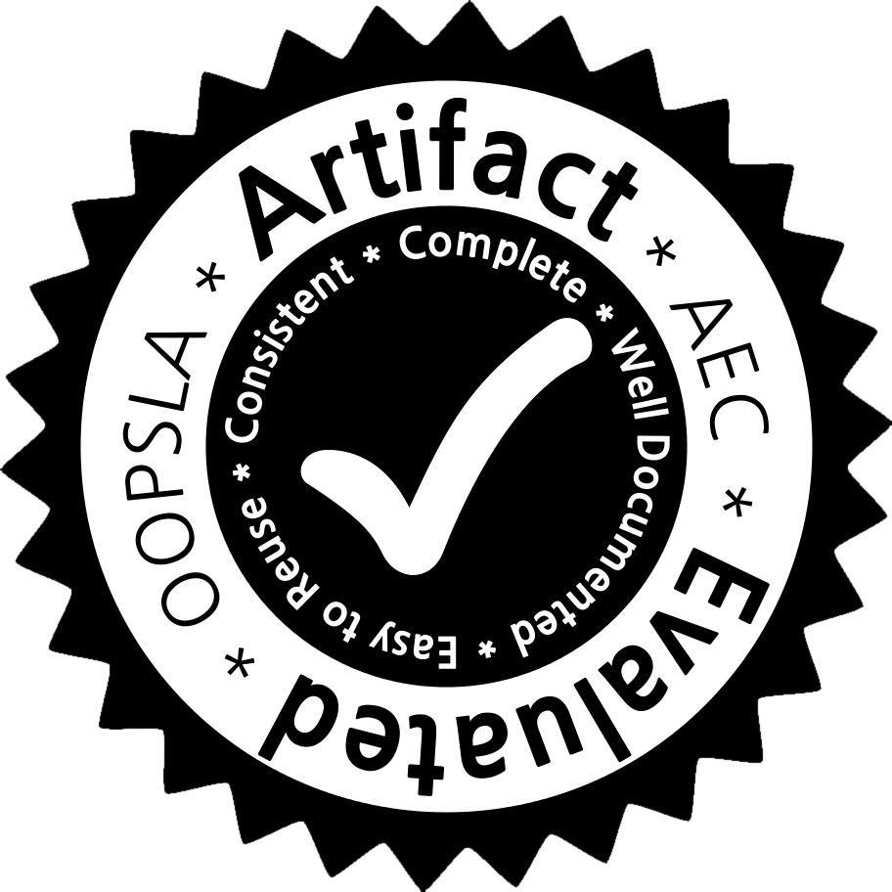
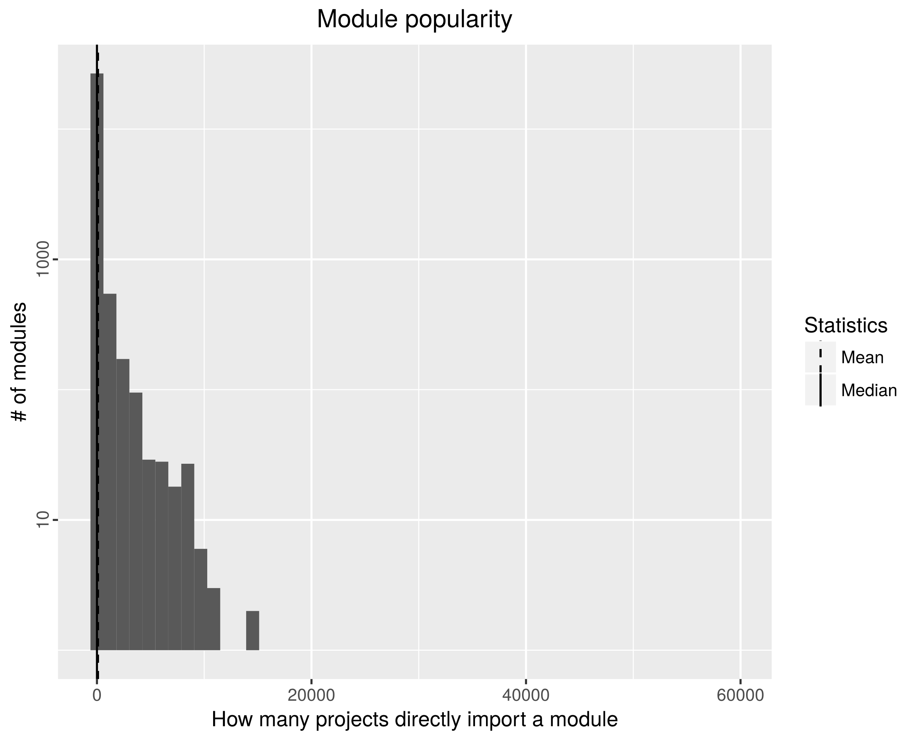



UC Irvine : Crista Lopes, Pedro Martins, Vaibhav Saini, Di Yang, Hitesh Sajnani CTU Prague : Petr Maj, Jakub Zitny Northeastern : Jan Vitek
DéjàVu A Map of Code Duplicates on GitHub
12%
unique
similar files
# of commits
If imitation is flattery, then the Internet is surprisingly full of praise. Specifically, the code programmers check into large scale software repositories is riddled with duplicates. Our paper involves the analysis of 4.5M non-fork projects on GitHub; 428M files in Java, C++, Python, and JavaScript. We found only 85M unique files. In other words, 79% of GitHub consists of duplicates. There is variability between languages. JavaScript has the highest rate, only 4%
of the files are distinct. Java has the least, 60% of files are distinct.
identical files
autogenerated
unintentional
intentional
# of files
9%
44%
30%
Intentional:
- similar functionality required in multiple
contents
- school assignments
Unintentional:
- boilerplate for Android applications
Autogenerated:
- Apache axis (web service framework)
- Android, Java
Introduction
79%
Java
26%
6/20
for : 1
while : 1
xy : 3
78 : 3
89 : 3
1 : 1
3 : 1
double : 3
for : 2
while : 1
xy : 3
78 : 3
89 : 3
1 : 1
3 : 1
73
12/20
2/20
// This is a function
void foobar(int foo, int bar) {
int baz = foo + bar;
++baz;
if (baz > 42)
return foo;
else
return bar;
}
FILE 2
FILE 4
77%
13%
1.8
1.5
12/20
Intentional:
- slight adaptation of algorithms for
different interfaces
Unintentional:
- different library versions
Autogenerated:
- Qt Meta-Object Compiler
void : 1
foobar : 1
int : 3
foo : 3
bar : 3
baz : 3
if : 1
42 : 1
return : 2
else : 1
void : 1
foobar : 1
int : 2
double : 1
foo : 3
bar : 3
baz : 3
if : 1
43 : 1
return : 2
else : 1
Corpus
10%
5/20
Similarity Levels
62
FILE 1
FILE 3
projects
C/C++
3/20
SourcererCC
files
262
(millions)
0.36
File Hash
Token Hash
Near-identical
0.89
33
72%
19%
3/20
Intentional:
- unittests
- database schemes
Autogenerated:
- all 17 examples are Django
file size (bytes)
Python
9%
empty file
17/20
# of files
Affected 80%
Contains 67% of B
All our data and results are available for download. Furthermore our entire pipeline, from downloading the projects to producing the clone maps is entirely automated in the form of R notebooks.
Project B
11%
1/20
Intentional:
- test with only changed name
Unintentional:
- different library versions (jQuery)
Autogenerated:
- angular.js with Yeoman
- expresss.js, grunt.js
5/20
Project A
7%
14/20
SCC
Affected 83%
Contains 80% of B
Artifact
download
tokenization
project clones
Project Inclusion
82%
DB import
metadata
processing
reporting
entire dataset
without
JavaScript
In JavaScript, over 70% of the identical duplicates of files come from accidental inclusion of node.js project dependencies.
tailored to language
language agnostic
251m
2008
2009
2010
2011
2012
2013
2014
2015
2016
http://mondego.ics.uci.edu/projects/dejavu - project website
https://github.com/PRL-PRG/dejavu-artifact - artifact
http://dejavu.ics.uci.edu – web service
91%
96%
References
87%
75m
10.1m

